Slide 1
MS Access tips and tricks
Colorado Crime Analysis Association

Slide 2
Open Data Base Connectivity
RMS
CAD
FI
JAIL
Traffic

Slide 3
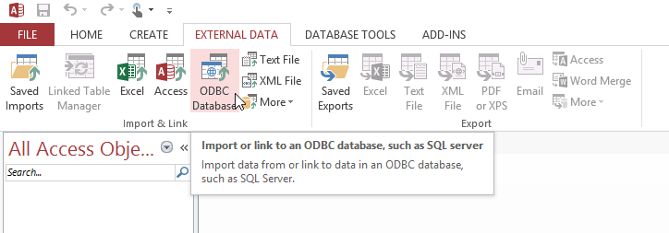
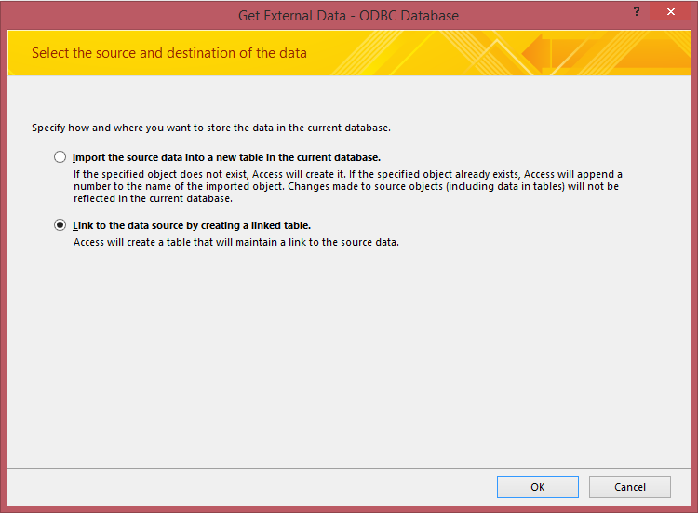
From your database, click on the EXTERNAL DATA tab and select “ODBC Database”.

Slide 4
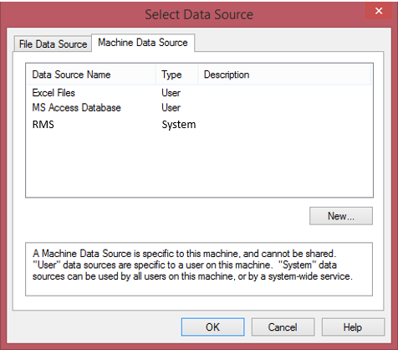
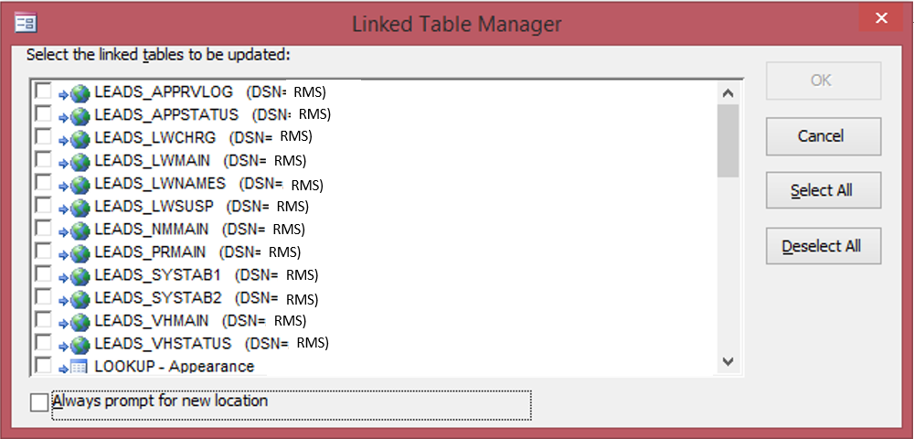
After entering your password you can choose which of your RMS tables you want to connect to. A data dictionary is useful.

Slide 5
Access components: Tables ~ where data lives Forms ~ where you can input data into the tables Queries ~ where you can retrieve / manipulate data Reports ~ where you can publish your data

Slide 6
Query Types: Select ~ retrieve and view data sets Make Table ~ make a table out of your selection Append ~ add data to an existing table Delete ~ remove certain records Crosstab ~ tabulates based on rows and columns

Slide 7
SQL Commands
SQL Snippets
Access queries are most precisely built in Design View. While some of the functions are predetermined by Access, there is a TON of functionality that can be added through the use of minor SQL commands. Common commands include:
>< Greater than, less than.
[ ] Indicated a field within the dataset.
() Separate a data section from a command.
Format Used in a query as a step of data manipulation to convert field types.
Left Parse a left section of a field
Mid Parse a mid-section of a field.
Right Parse a right section of a field.
#1/1/1900# Designates a date.
IIF “If, then” statement.
Len Length
Trim Removes extra spaces.
Val Formats as a value (number).
Str Formats as a string (text).
Now Indicates today’s date.
& Used to concatenate.
, Separates values
/ Divides
* Multiplies
Sum Totals a numeric field
“ “ Designates text
Is Null Blank
Is Not Null Not Blank

Slide 8
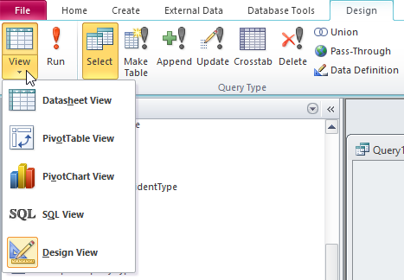
Query Views
View Data
Tabular
Chart
SQL (savable)
Criteria

Slide 9
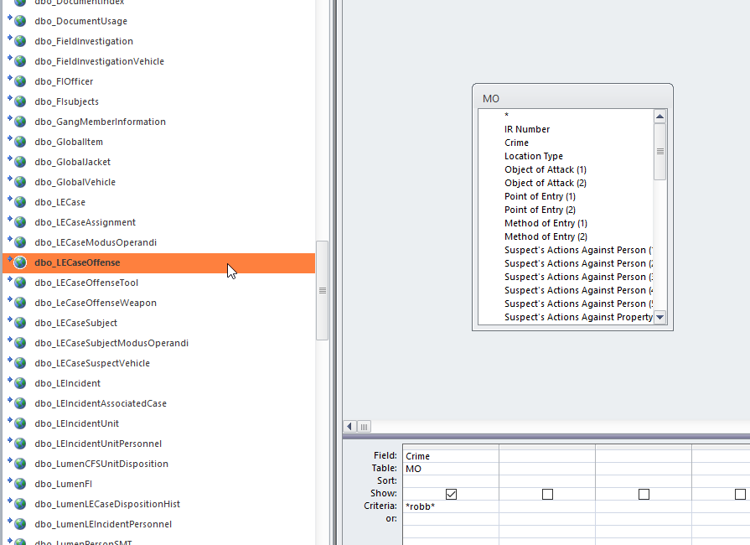
Adding tables to query
Drag and Drop or click the “Show Table” button

Slide 10
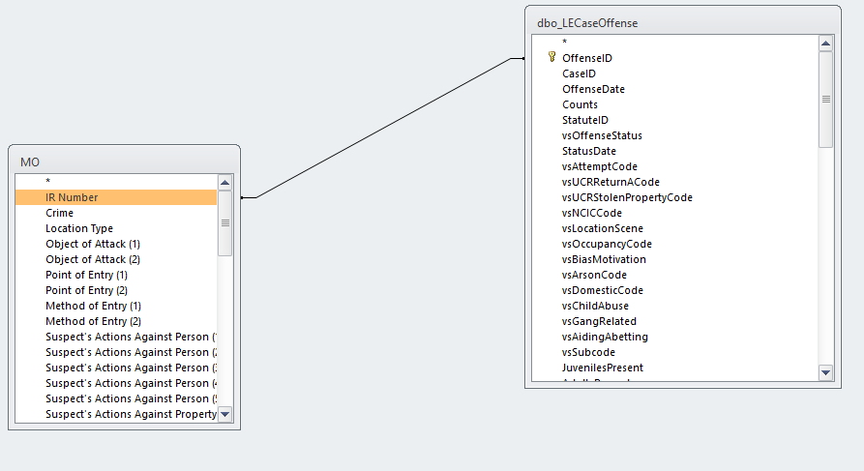
Linking tables
Drag a link between matching fields

Slide 11
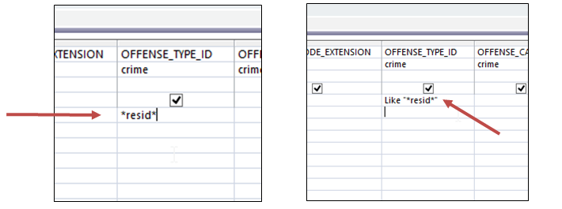
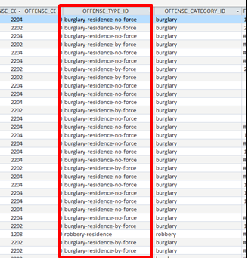
Adding Criteria

Slide 12
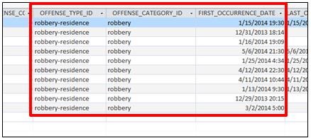
Adding Criteria

Slide 13
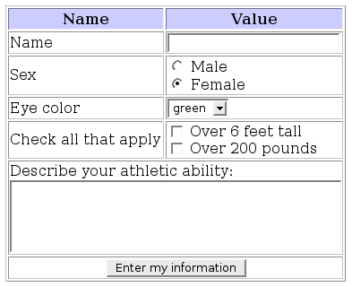
Automating Reports

Slide 14
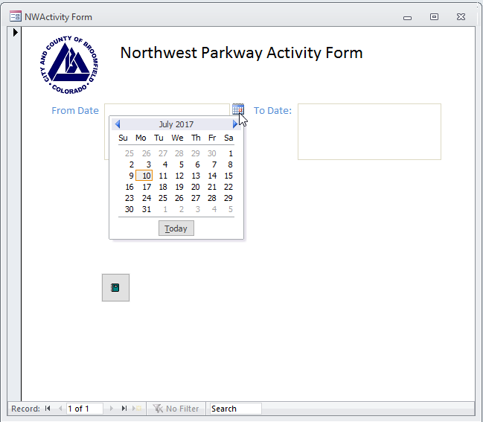
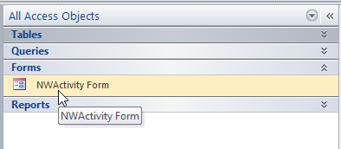
Automating Reports
Action Button

Slide 15
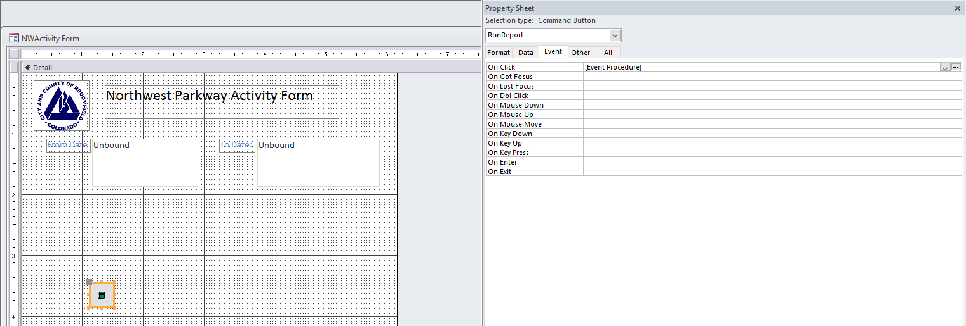
Automating Reports

Slide 16
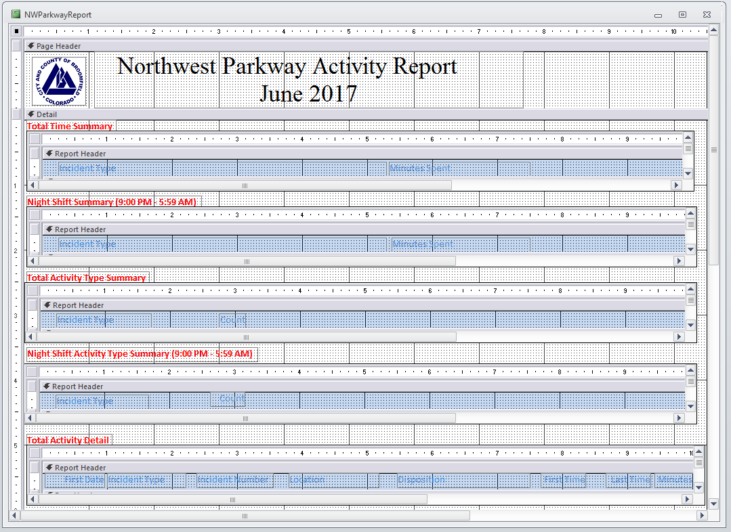
Automating Reports
Report can consist of one query, or several sub-reports that are based on different queries.

Slide 17
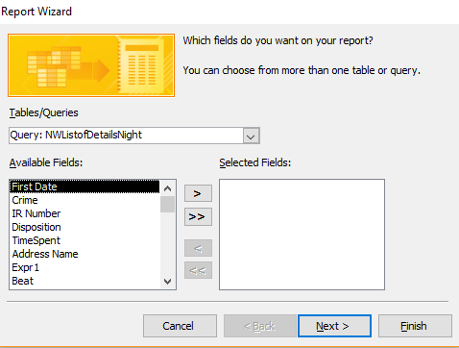
Automating Reports
Reports can be written off of queries, so when the report is generated, the query is also run.

Slide 18
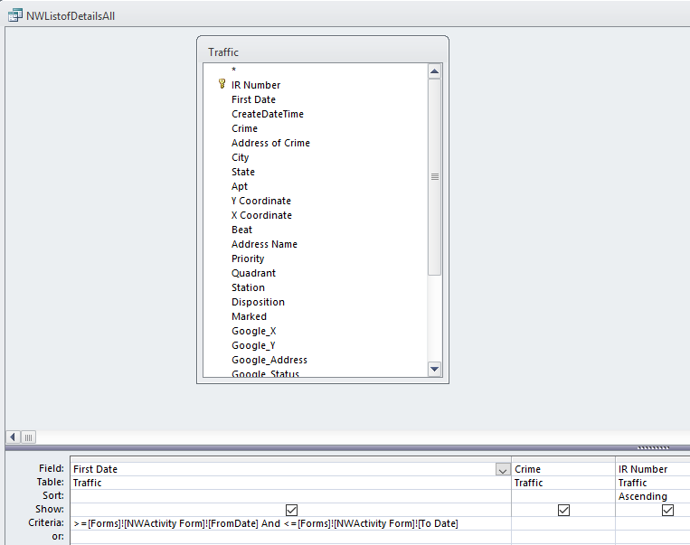
Automating Reports
The query criteria is dependent upon the dates (for instance) that are entered in the form.

Slide 19
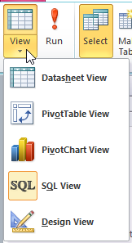
Saving Queries
Any query that you have built can be viewed and / or edited in SQL View. It can also be copied and pasted to a word document for use elsewhere.

Slide 20
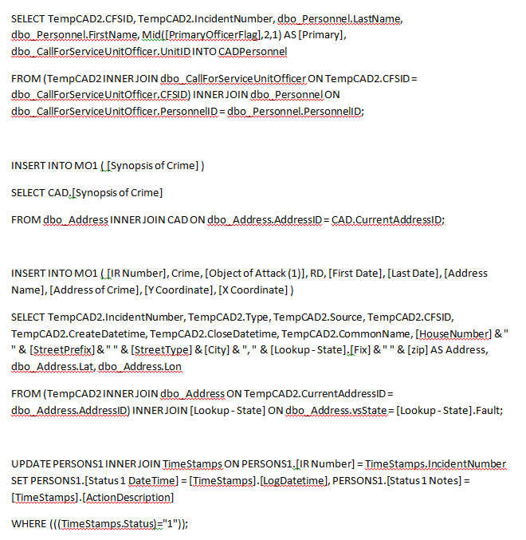
Saving Queries

